Slide 1
Study Project
Math F266
Under the Guidance of
Dr. Krishnendra Shekhawat
Title: Enumeration of Maximal Rectangular Floor Plans
By- Rahil N Jain
ID No. 2017B4A70541P
Lakshya agarwal
ID No. 2017B4A70630P

Slide 2
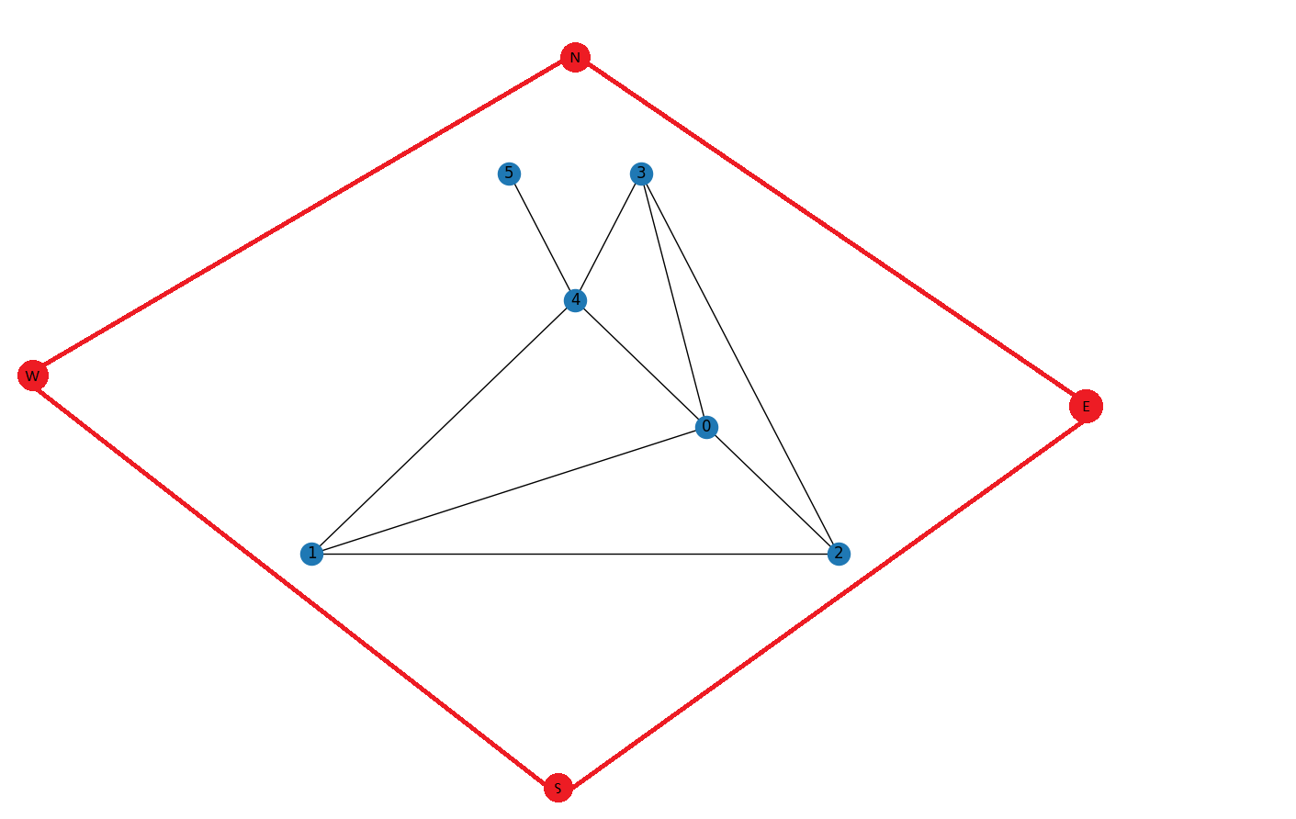
IO Method
Consider the Inner Graph given below. The task is to add 4 outer boundaries to it.

Slide 3
Definitions
Inner Graph:-The initially given dual graph of the given RFP on which we have to add four rooms.
NESW vertices:-The four vertices to be added are names as NESW being ‘North’ , ‘East’ , ‘South’ ,’West’ respectively.
Outer Graph:- The final graph after adding the NESW vertices is called the outer graph
I-I edges:- Edges of the given inner graphs.
O-O edges:- Edges between NESW vertices.
I-O edges:- Edges between the vertices of inner graph and NESW vertices.

Slide 4
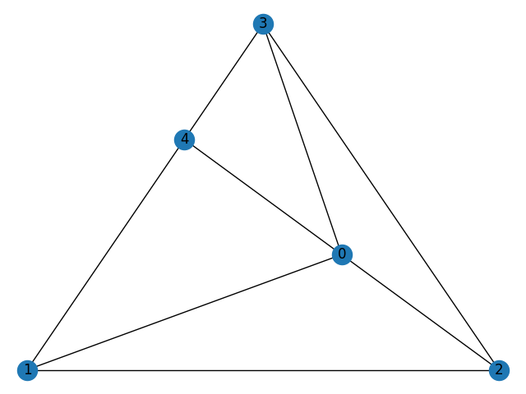
Definitions
4. Wrapped Vertices:-
Those vertices which have a cycle in the subgraph formed from its neighbors.In the figure, the vertex 0 is a wrapped vertex because the subgraph formed from its neighbors 1,2,3,4, has a cycle i.e, 1-2-3-4-1.

Slide 5
Proposition 1 : A maximal rectangular dual graph has 3n-7 edges
Proposition 2 : A degree 1 vertex must have exactly 3 I-O edges
Proposition 3 : A cut vertex must have exactly 2 I-O edges.
Proposition 4 : All cut vertices must be connected to the same 2 opposite NESW vertices.
WLoG let us take it East and West.
Proposition 5 : A wrapped vertex has 0 I-O edges.
Proposition 6 : The vertices between 2 cut vertices must have exactly 1 I-O edge
Proposition 7 : As the inner graph is connected, each vertex has at least one of its sides block by the blocks of the inner graph. So as each vertex has 4 sides to be covered, the maximum number of I-O edges that can be added to the rest of the vertices is 3.
Proposition 8 : Assume a generic vertex v, which doesn’t come under the above criteria of vertices. Let the degree of v be d. Now the maximum number of sides the neighbors of v can take is d. So the minimum number of I-O edges for v to be added must be 4-d. Now if d is greater than or equal to 4, then the minimum number must be zero.

Slide 7
Basics of Edge counting
Let n be the number of vertices in the inner graph
Total edges in the outer graph is 3*(n+4)-7 = K
There are some edges which are evident so we start forming the outer graph
by counting these vertices.
I-I edges
O-O edges
I-O edges
Edges from cut vertices = 2
Edges from degree 1 vertices = 3
Edges from wrapped vertices = 0
Edges from vertices between 2 consecutive cut vertices = 1
Edges from the minimum number of generic vertices
If K = 0 after this process then there is a unique solution else

Slide 8
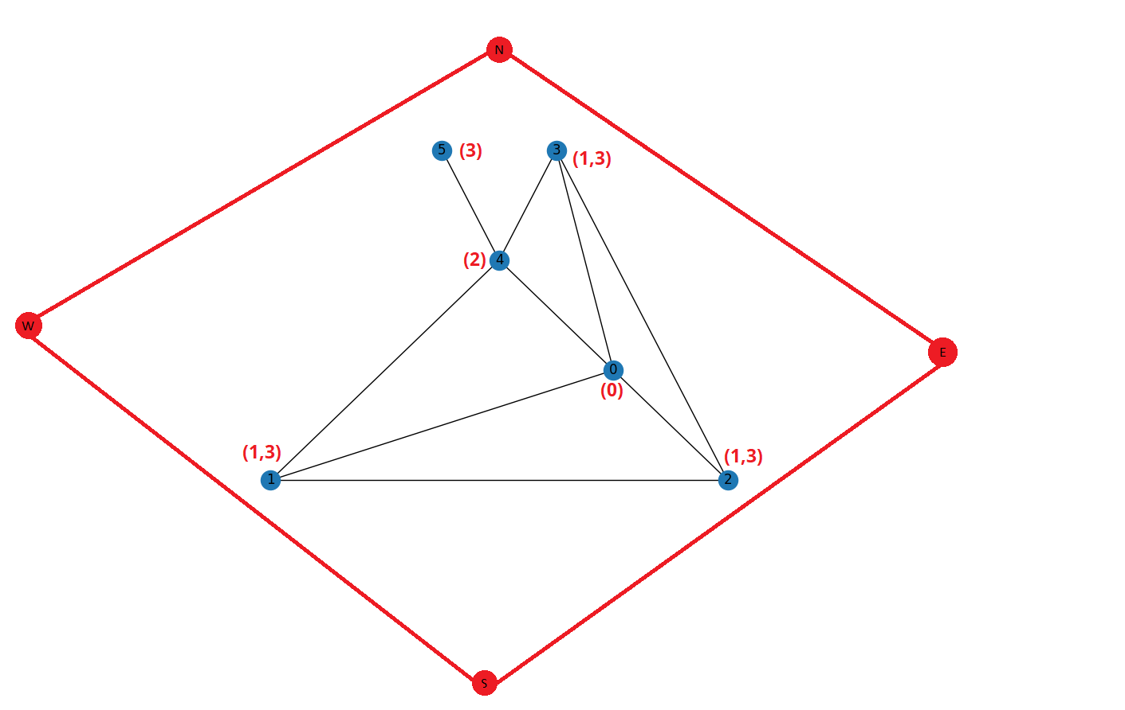

Slide 9
Example of edge counting :
K = 3 * ( 6+4) - 7
K = 23
K- I-I
K= 23- 9 = 14
K - O-O
K = 14 - 4 = 10
K - I-O
K = 10 - 8 = 2
Remaining edges is 2
Possible non-isomorphic combinations for
2 edges are adding I-O to
1,1
1,2
1,3
2,2.

Slide 10
Completion Problem
Let us consider the outer graph with I-O edges after edge counting. Let this graph be G. Figure represents G
N
1
(3)
(2)
2
(1)
(1)
W
E
3
5
(1)
6
4
(1)
(2)
7
(3)
8
S

Slide 11
Steps to be followed for completion
Find the set of cut vertices.
Connect the Cut vertices to East and West.
The graph is divided into sections of biconnected subgraphs.
Find the outer boundary for each biconnected subgraph.
Start connecting.

Slide 12
Cut vertex set = { 2 , 7 }
Cut vertex connection.
N
Section 1
1
Section 2
2
3
5
W
E
4
6
Section 3
7
8
S

Slide 13
Steps: connection of first and last section is done in a circular fashion
N
Section 1
1
2
3
5
W
E
4
6
7
8
S

Slide 14
Steps:
Find the outer boundary
Start from a cut vertex and connect all the vertices to East till the next
Cut vertex , after that connect rest
of them to West
N
1
Section 2
2
3
5
W
E
4
6
7
8
S

Slide 15
The final Completed outer maximal dual graph
N
1
2
3
5
W
E
4
6
7
8
S

Slide 16
Thank You

